Slide 1
Introduction to Python
Python Crash Course
DATA 601

Slide 2
Before We Start
Please follow the directions in the following slides and make sure that you have a healthy python environment to run your own codes while learning!
Some of the early lectures will have some advanced subjects. If you don’t understand, please take a note but do not panic. In the following lectures, we will cover those advanced subjects in detail.

Slide 3
Download & Install
Recommended Approach:
Download latest version of Anaconda Distribution and install it
(skip registration)
https://www.anaconda.com/download
Once the installation complete, run Anaconda Navigator
Alternatively:
Download Python 3 (or newer version) from:
https://www.python.org/downloads/
and install it. This will require individual module installation

Slide 4
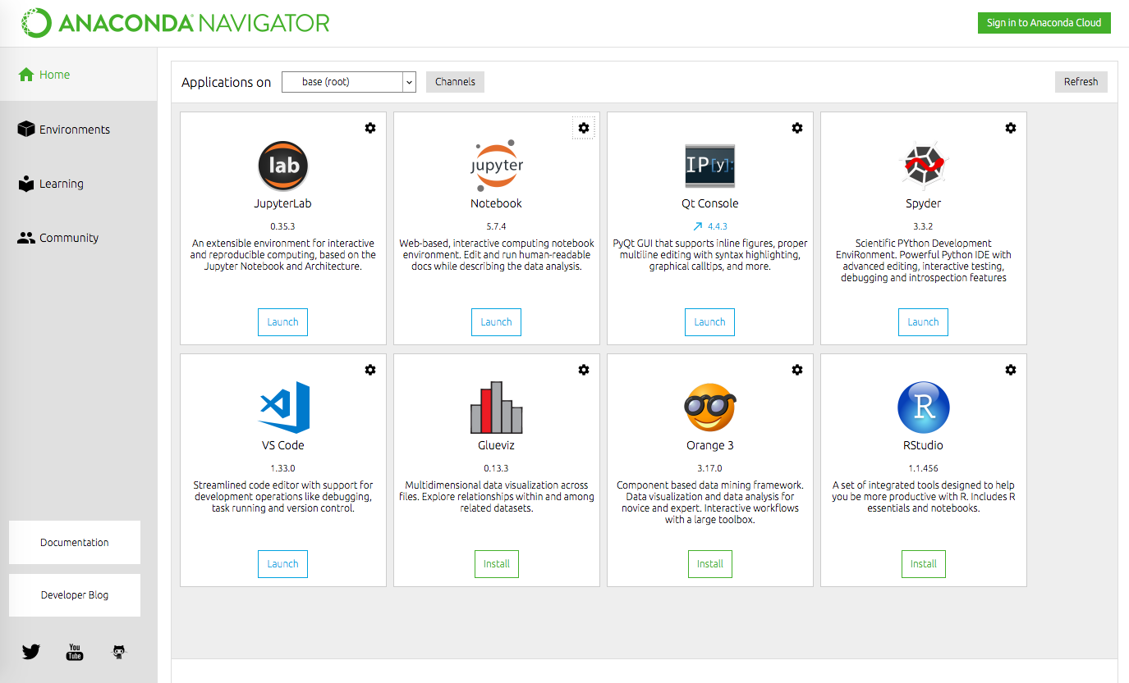
Jupyter Notebook
Launch “Jupyter Notebook” using the Anaconda Navigator

Slide 5
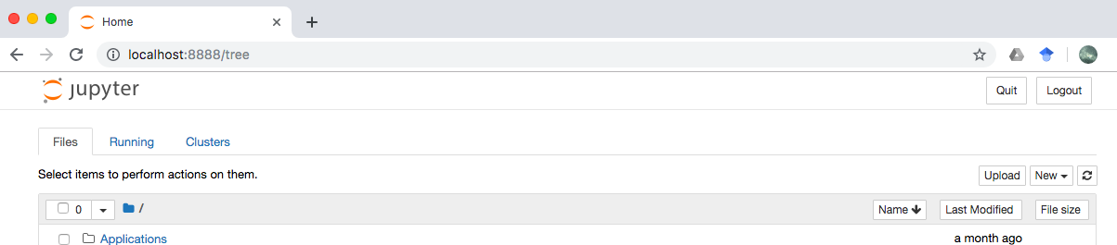
Jupyter Notebook
If your internet browser opens a new tab like this, you are ready to go
If somehow it didn’t work, backup plan is using Google COLAB

Slide 6
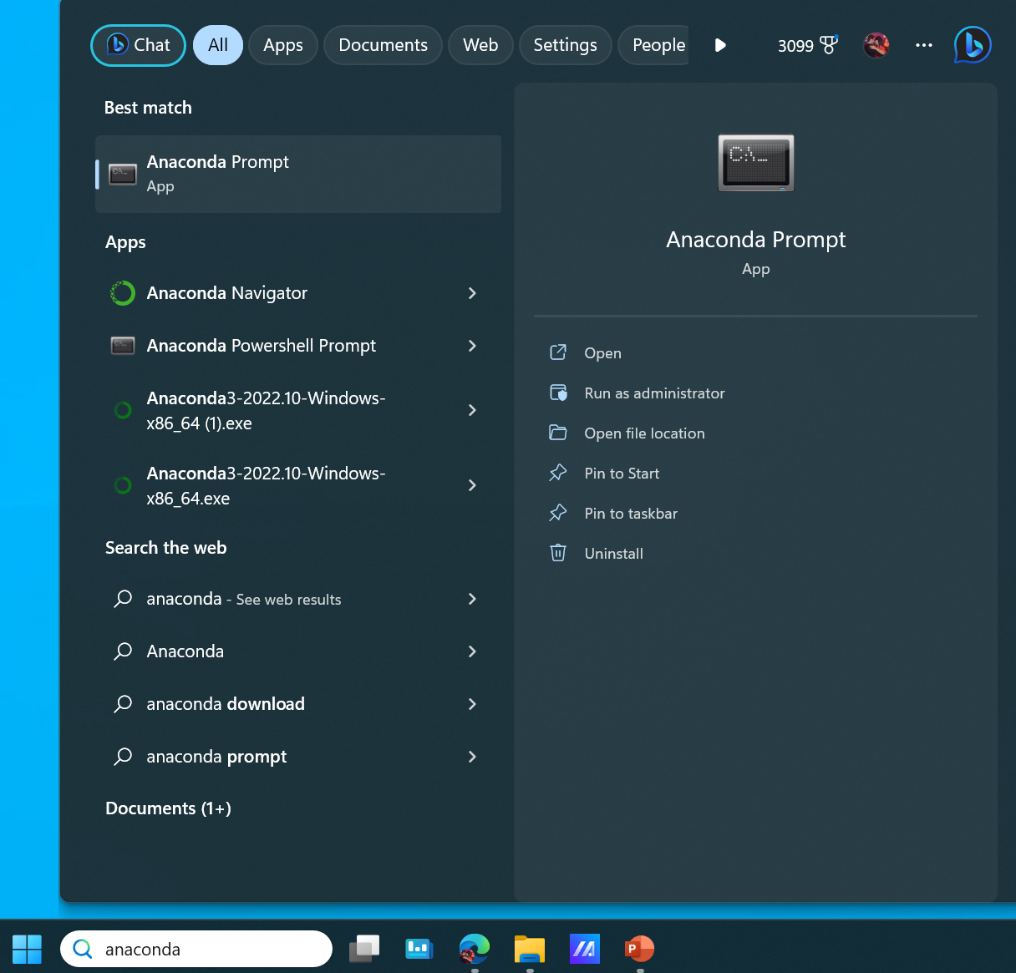
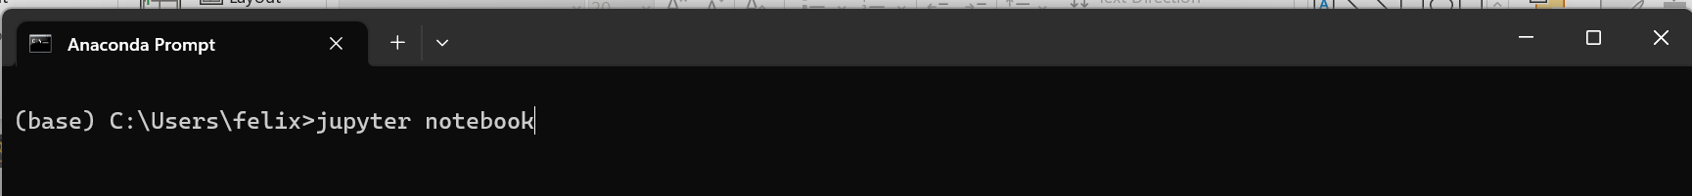
Jupyter Notebook
Jupyter Notebooks can also be launched from the Terminal (e.g., Anaconda Prompt)
Then typing “jupyter notebook”

Slide 7
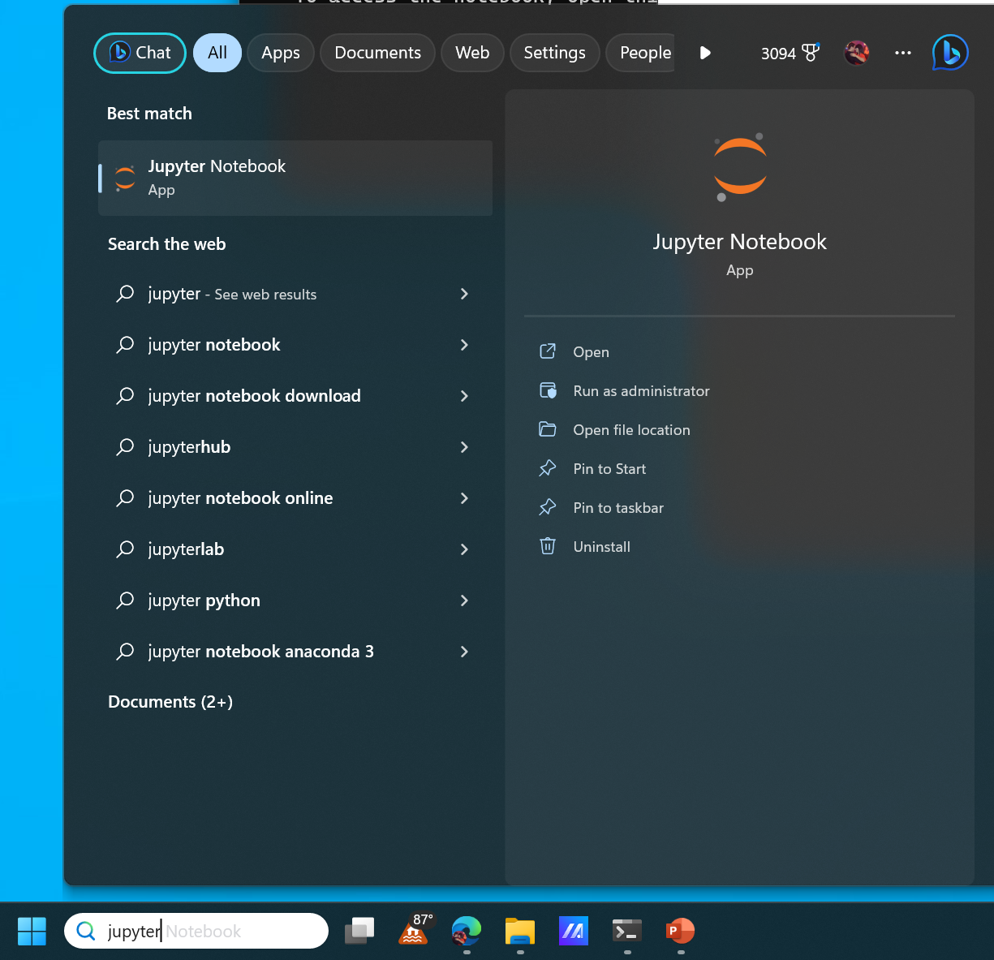
Jupyter Notebook
Jupyter Notebooks can also be launched from the windows search bar by searching “Jupyter Notebook”

Slide 8
Jupyter Notebook: Starting Directory
Changing the starting directory may depend on your preferred method of opening Jupyter Notebook and your Operating System
The following reference has various methods of updating the starting directory:
How to change the Jupyter start-up folder - Stack Overflow
Methods include:
- Creating a configuration file
- Changing the Jupyter Notebook Windows Shortcut File Target. Replace the "%USERPROFILE%“ to your directory “C:\Directory\Python_Projects"

Slide 9
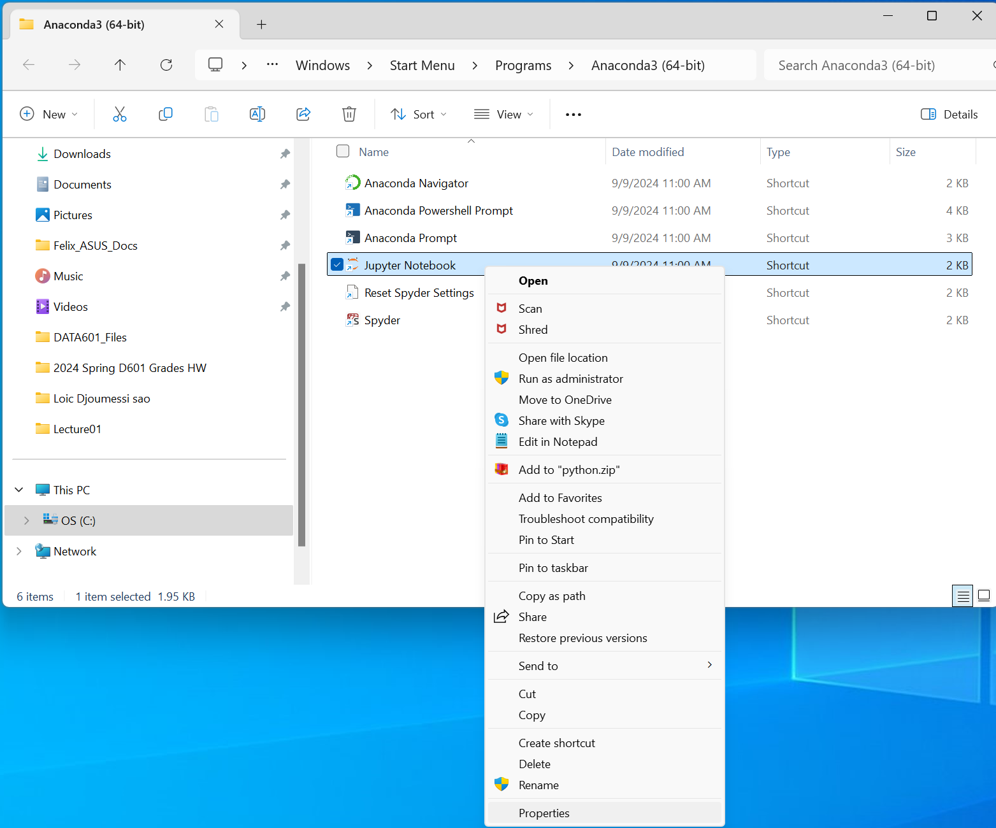
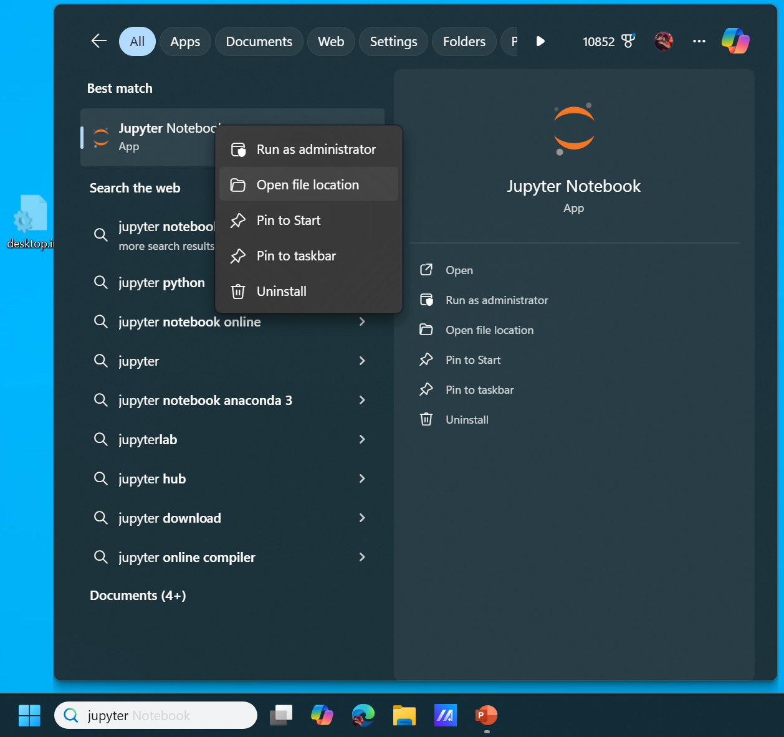
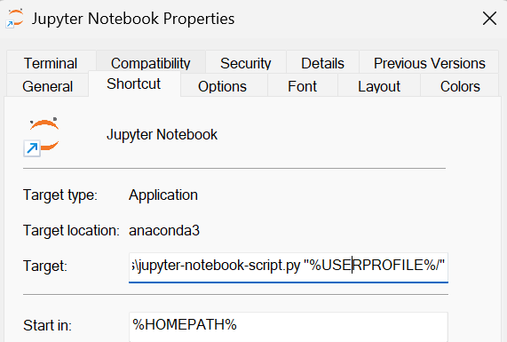
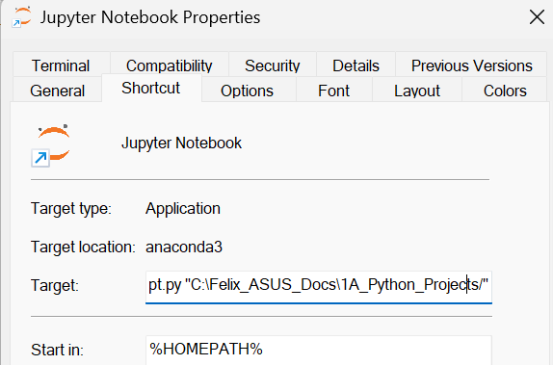
Changing the Jupyter Notebook Windows Shortcut File Target

Slide 10
Google Colab
If you don’t have an UMBC email or another gmail account, first you need to create a Google Account for yourself at
https://accounts.google.com
Sign into your google account. Then go to
https://colab.research.google.com/
What you see is free Jupyter notebook environment that requires no setup and runs entirely in the cloud.
1. Click File 2. Choose “Python 3 Notebook”
Anaconda Cloud
Anaconda cloud is also similar to Google Colab which allows running Jupyter Notebooks in a cloud environment.
https://id.anaconda.cloud/

Slide 11
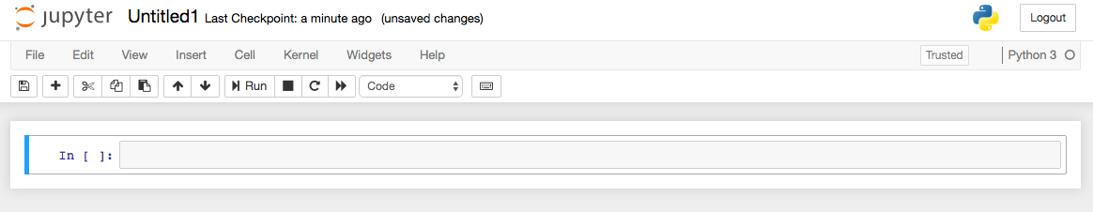
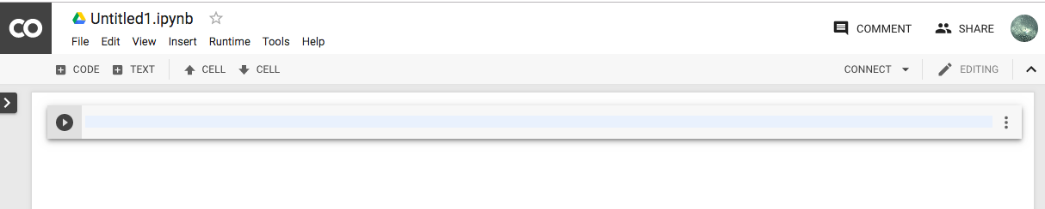
If you All Have either of these, We are ready to start

Slide 12
What is Python?
Python is an object-oriented, high-level programming language with integrated dynamic semantics primarily for web and app development.
Python is relatively simple, so it's easy to learn since it requires a unique syntax that focuses on readability.
Python supports the use of modules and packages, so that programs can be designed in a modular style and code can be reused across a variety of projects.

Slide 13
Why Python?
Open Source/Free: No need to worry about licences
Cross-platform: Can be used with Windows/Macs OS/Linux – even Android and iOS!
Full-featured Packages: If there’s something you want to do, there’s probably a package out there to help you
Code Portability: With most code, it can run unaltered on a plethora of computers so long as all the required modules are supplied
Large and Growing Community: People from all fields from Data Science to Physics are coding in Python, creating a diverse and rich community of experts all over.

Slide 14
Tools
Anaconda Distribution: Tool and code distribution that includes various data science tools (Python and multiple data science libraries, Jupyter Notebooks, etc.).
Jupyter Notebooks: Primary tool used in the class.
Google Collaboratory: Write Python code in Jupyter notebooks.
Github: internet hosting service for software development and version control. Will be used to host class documents, presentation and material.
Integrated Development Environments (IDE): Graphical user interface to help build applications.
Jupyter Notebooks
MS Visual Studio Code
Anaconda Spyder
PyCharm
Text Editors:
Can be used to write, edit and modify code files (e.g., Python files)

Slide 15
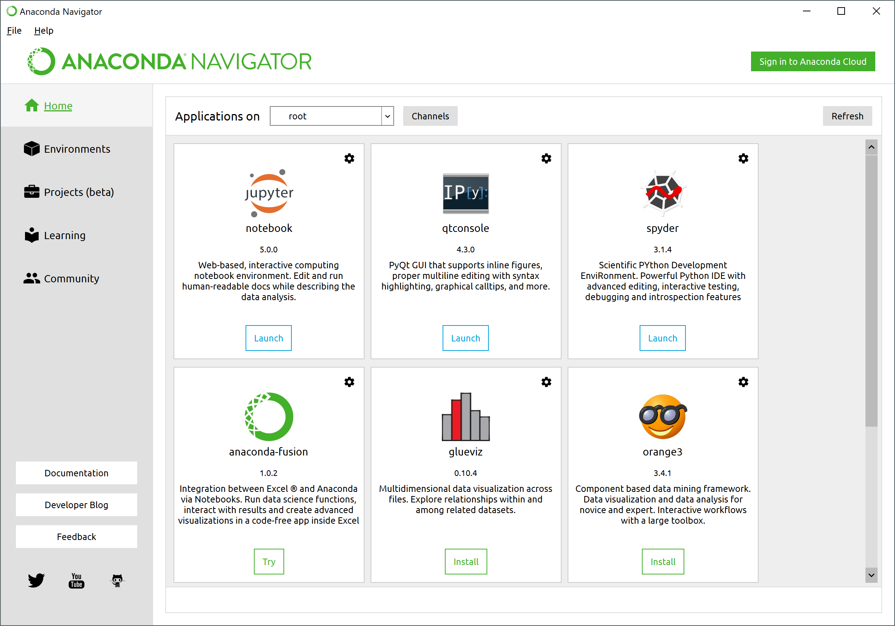
Anaconda: What We’ll be Using
Anaconda is a distribution that uses the conda tool to manage packages.

Slide 16
JUPYTER Notebook
PRO TIP:
From command line:
$ jupyter notebook
Can launch from Anaconda: runs a python session in the background

Slide 17
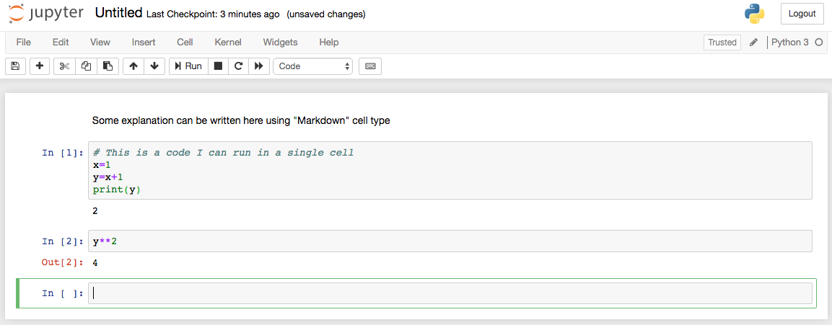
JUPYTER Notebook
PRO TIP:
Change "Code” to “Markdown” for explanations
Runs a “notebook” in a web browser. Keeps code and notes together.

Slide 18
JUPYTER Notebook
Code (cells run independently)

Slide 19
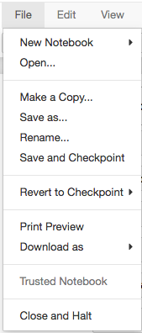
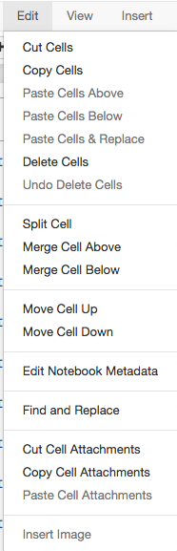
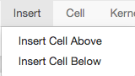
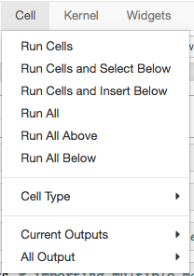
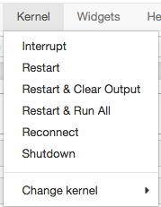

Slide 20
Modules: The Power of Python
The base language of Python is actually quite limited.
Most of its power comes from Modules (or sometimes referred to as Packages)
Modules must be imported before they can be used:
In [1]: import math
In [2]: import math, statistics
Importing single or multiple modules on a single line
Once imported, you can access functions or variables:
In [3]: math.cos(math.pi)

Slide 21
Modules: The Power of Python
Sometimes typing the module name all the time can be annoying in which case:
Creating a shorter name or just getting the function you want
In [1]: import numpy as np
In [2]: from numpy import zeros
Once imported, you can access functions or variables:
In [3]: np.ones(5)
Out[3]: array([1., 1., 1., 1., 1.])
In [4]: zeros(5)
Out[4]: array([0., 0., 0., 0., 0.])

Slide 22
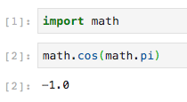
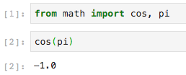
Modules: The Power of Python
Observe the difference
vs.

Slide 23
Modules: The Power of Python
PRO TIP:
Some places will show examples that involve importing all functions in a module by:
from module1 import *
While this may seem handy, it is dangerous. DON’T DO THIS!
It messes with your namespace!

Slide 24
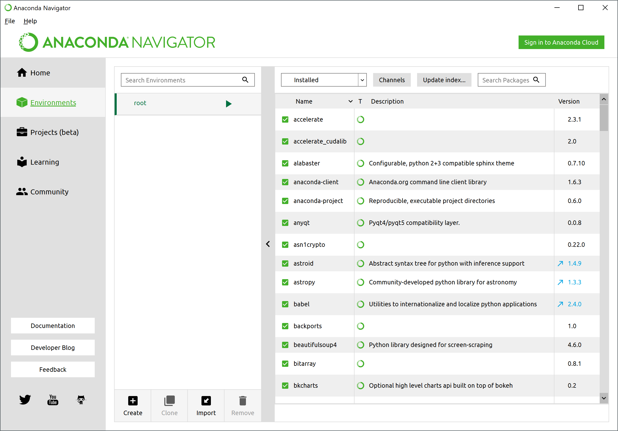
Installing New Modules
Anaconda provides the majority of modules you’ll want and/or need automatically. But there are modules that you’ll likely want to get. Anaconda makes this easy using the Environments Tab

Slide 25
Installing New Modules
Python also makes installing packages easy in general using conda on the command line:
$ conda install numpy
This downloads and installs any package available on the (centralized) Anaconda repository.
To find a package:
$ conda search numpy
We will talk about modules in great detail later.
For the moment, just know that Python’s power comes from modules and they are very easy to install

Slide 26
Python Overview

Slide 27
Basics of a Script: Comments
The most important part of any script
In [1]: # This is a comment
In [2]: # This is also a comment
For longer comments (in a script for instance):
'''
This text is in a comment
So is this text
'''
This text is outside a comment

Slide 28
Basics of a Script: Indentation
In the next slide, there is a “for loop” and an “if statement”
We will learn how those loops and statements work later.
The purpose of the next slide is showing you that indentation is important for Python

Slide 29
Basics of a Script: Indentation
Python uses indents to indicate blocks of code – no brackets!
# Indentation example
x = 1
y = 2
for i in (1, 2, 3):
x = x + i
y = y + i
if x > y:
print('Something is wrong!')
print(x, y)
print('All done.')
Let your text editor deal with indenting for you. And when you need to do it yourself, use spaces not tabs. Python is picky about it!

Slide 30
Basics of a Script: Variables
What are variables?
Variables are the combination of an identifying label and a value, often a literal like 2 or "hello world". The label/identifier is attached to the value thus:
This is called variable assignment.
Once assigned, when you use the label, you get the value:
Note that this is not the same as:
In [1]: a = 10
In [2]: print(a)
Out[2]: 10
In [3]: print("a")
Out[2]: a

Slide 31
Basics of a Script: Variables (Cont…)
There is no need to declare any variable type before setting it
In [1]: x = 1 # No need to declare x is an integer
In [2]: y, z = 100, 200
Anything can be a variable in python: numbers, strings, functions, modules, et cetera. You can check out what type the variable is by:
In [3]: type(x)
Out[3]: int
They are called variables because you can change the value:
In [4]: x=1
In [5]: print(x)
Out[5]: 1
In [6]: x=2.1
In [7]: print(x)
Out[7]: 2.1

Slide 32
Basics of a Script: Variables (Cont…)
The label is just pointing to the value, which is stored somewhere in the computer memory.
In [1]: a=10
In [2]: b=a
In [3]: b
Out[3]: 10
In [4]: b=20
In [5]: a
Out[5]: 10
In [6]: b
Out[6]: 20

Slide 33
Variable identifiers
Names can be any continuous word/s, but must start with a letter or underscores.
There is no relationship between a variable's value or use and its name. In the last simple examples, a and b were fine, but generally you should name variables so you can tell what they are used for:
radius = 10
is more meaningful than
a = 10
or
bob = 10
In general, the more meaningful your names, the easier it will be to understand the code, when you come back to it, and the less likely you are to use the wrong variable.
Notes:
We tend to use i, j, and k for counters because in the first third generation language, FORTRAN, letters had to be used for certain variables, and certain types of number could only be assigned to certain letters. Integer values (whole numbers) could only be assigned to the letters from i (for integer) onwards. For this reason, people still use i, j, k for counting things (but not lowercase "L" -- it looks too much like a one).

Slide 34
Name Style
Style conventions aren't syntax, but allow all coders to recognise what an element is.
There's a styleguide for Python at:
https://www.python.org/dev/peps/pep-0008/
But it goes out of its way to avoid talking about variable names.
The community preference seems to be for lowercase words to be joined with underscores; what is called (coincidentally) snake_case:
perimeter_of_a_square
Though where Python is working with C or other code, the more conventional camelCase is sometimes used:
perimeterOfASquare
Either way, start with a lowercase letter, as other things start uppercase.

Slide 35
More on variables
You may see variables described as containers for values, but this isn't true and isn't helpful. Think of them as labels and values.
As we'll see later on, it is quite easy to get confused about what a variable is referring to, and thinking about them as a identifier/label and value helps.

Slide 36
Why we use variables?
Variables are generally used to hold the result of calculations and user inputs. These are things we can't predict before the code is run.
Some things we can predict the value of, for example, the 4 in:
perimeter = 4 * length_of_side # perimeter of a square
Such literals are hardwired in.
Even such literals are often better put in a variable at the top of the file, as changing the variable instantly allows us to change the value throughout:
number_of_sides = 4
perimeter = number_of_sides * length_of_side
This now works for any regular shape if we change number_of_sides.

Slide 37
Values
What kinds of things can we attached to variable labels?
Everything!
Literals like 1, 1.1, "a", "hello world".
But also whole chunks of code.
All the code and values in the computer is held in the form of binary data. We don't usually see this, but it is. It has to be: computers are just very complicated sets of on and off switches.
If values are just spaces in memory with something in them, and all code and values is binary, if we can attach a label to a value in memory, we can attach it to code in memory.
This is the basis of object oriented computing.

Slide 38
Objects
Objects are chunks of code that are wrapped up in a particular way.
One thing this format enables is the attaching of labels to them to create variables.
Objects can have their own functions and variables, so you can have variables inside other variables.
Objects generally do some particular job.
We’ll talk about them more later.

Slide 39
Values
In Python (but not all other languages), functions themselves are objects that can be given labels:
>>> a = print
>>> a("hello world")
hello world
This makes it incredibly powerful: for example, we can pass one function into another (the core of functional programming).
>>> dir(a)

Slide 40
Values
How does the computer know what a variable is?
For Python, it works it out. This takes it a little time, but means it is much more flexible.
This is why Python is more time and energy consuming compared to C, Fortran, etc.

Slide 41
Basics of a Script: Primitive Variables
There are only a few built-in variables in python, with standard operations:
Strings (str)
Integers (int)
Floats (float)
Any form of text. These can be enclosed in single (‘) or double (“) quotes.
In [1]: var1 = ‘This is a String’
In [2]: var2 = “This is also a String”
When added, they make a longer string:
In [3]: var1 + var2
Out[3]: 'This is a StringThis is also a String'

Slide 42
Basics of a Script: Primitive Variables
There are only a few built-in variables in python, with standard operations:
Strings (str)
Integers (int)
Floats (float)
They also accept escape characters (i.e., \n, \t, \a)
In [1]: var1 = 'This is a String \n'
In [2]: var2 = 'This is also a String'
When added, they make a longer string:
In [3]: print(var1+var2)
Out[3]: This is a String
This is also a String

Slide 43
Basics of a Script: Primitive Variables
There are only a few built-in variables in python, with standard operations:
Strings (str)
Integers (int)
Floats (float)
Any integer (…, -1, 0, 1, …). Mathematical operations are as you expect
In [1]: var1, var2 = 1, 2
They are subject to floating point math:
In [2]: var1 / var2 # Regular division
Out[2]: 0.5
In [3]: var1 // var2 # Integer division – drop fraction
Out[3]: 0

Slide 44
Basics of a Script: Primitive Variables
There are only a few built-in variables in python, with standard operations:
Strings (str)
Integers (int)
Floats (float)
Any integer (…, -1, 0, 1, …). Mathematical operations are as you expect
In [1]: var1, var2 = 5, 2
They are subject to floating point math:
In [2]: var1 / var2 # Regular division
Out[2]: 2.5
In [3]: var1 // var2 # Integer division – drop fraction
Out[3]: 2

Slide 45
Basics of a Script: Primitive Variables
There are only a few built in variables in python:
Strings (str)
Integers (int)
Floats (float)
Any real number (1.0, 2.5, 1e25). Mathematical operations are as you expect
In [1]: var1, var2 = 1.0, 2e2
In [2]: var1, var2
Out[2]: (1.0, 200.0)
In [3]: 1/2.0 # int and float results in float
Out[3]: 0.5

Slide 46
Basics of a Script: Primitive Variables
There are only a few built in variables in python:
Strings (str)
Integers (int)
Floats (float)
Any real number (1.0, 2.5, 1e25). Mathematical operations are as you expect
In [1]: var1, var2 = 1.0, 2e2
In [2]: var1, var2
Out[2]: (1.0, 200.0)
In [3]: 1/2.0 # int and float results in float
Out[3]: 0.5

Slide 47
Basics of a Script: Primitive Variables
There are only a few built in variables in python:
Strings (str)
Integers (int)
Floats (float)
Any real number (1.0, 2.5, 1e25). Mathematical operations are as you expect
In [1]: var1, var2 = 1.0, 2e2
In [2]: var1, var2
Out[2]: (1.0, 200.0)
In [3]: 1/2.0 # int and float results in float
Out[3]: 0.5
NOTE:
There is also a Boolean data type (bool). It can only have the values True or False.

Slide 48
Python and Complex Numbers
Python can handle complex numbers as well
In [1]: w = 3+4j
In [2]: print(type(w))
Out[2]: <class 'complex'>
Python and Scientific Numbers
Float can also be scientific numbers with an "e" to indicate the power of 10.
In [1]: x= 1.1e3
In [2]: print(x)
Out[2]: 1100.0

Slide 49
CASTING
There may be times when you want to specify a type on to a variable.
This can be done with casting
int() constructs an integer number from
an integer literal,
a float literal (by rounding down to the previous whole number),
or a string literal (providing the string represents a whole number)
In [1]: x = int(1)
In [2]: y = int(2.8)
In [3]: z = int("3")
In [4]: print(x,y,z)
Out[4]: 1 2 3

Slide 50
CASTING (Cont…)
float() constructs a float number from
an integer literal,
a float literal or
a string literal (providing the string represents a float or an integer)
In [1]: x = float(1)
In [2]: y = float(2.8)
In [3]: z = float("3")
In [4]: w = float("4.2")
In [5]: print(x,y,z,w)
Out[5]: 1.0 2.8 3.0 4.2

Slide 51
CASTING (Cont…)
str() constructs a string from a wide variety of data types, including strings, integer literals and float literals
In [1]: x = str("s1")
In [2]: y = str(2)
In [3]: z = str(3.0)
In [4]: w = str('Python Rocks')
In [5]: print(x,y,z,w)
Out[5]: s1 2 3.0 Python Rocks

Slide 52
More on Strings
Note that Python stores strings as arrays of bytes representing unicode characters. For example
A_String = ‘AbC DeF’
len(‘A_String’) returns 7
A_String[0] returns A
A_String[1] returns b
A_String[-1] returns F
A_String[3] returns an empty space

Slide 53
Some Very Useful String Methods
strip(), removes any whitespace from the beginning or the end
In [1]: Name3 = " Albert Einstein ”
In [2]: print(Name3.strip())
Out[2]: Albert Einstein
lower() method returns the string in lower case
In [3]: Name3 = "Albert Einstein”
In [4]: print(Name3.lower())
Out[4]: albert einstein
upper() method returns the string in upper case:
In [5]: print(Name3.upper())
Out[5]: ALBERT EINSTEIN

Slide 54
Some Very Useful String Methods (Cont…)
replace() method replaces a string with another string:
In [1]: prices = "$100, $200, $87, $500"
In [2]: print(prices.replace("$", "€"))
Out[2]: €100, €200, €87, €500
In [3]: prices = "$100, $200, $87, $500"
In [4]: print(prices.replace("$", ""))
Out[4]: 100, 200, 87, 500

Slide 55
Some Very Useful String Methods (Cont…)
split() method splits the string into substrings if it finds instances of the separator
In [1]: prices = "$100, $200, $87, $500"
In [2]: print(prices.split(","))
Out[2]: ['$100', ' $200', ' $87', ' $500']
The output is a list of strings. We’ll talk about “lists” in the next session
In [3]: A_sentence = "I will go shopping today"
In [4]: print(A_sentence.split(" "))
Out[4]: ['I', 'will', 'go', 'shopping', 'today']

Slide 56
Arithmetic Operators
Input
Output
x = 12.0
y = 2.0
addition = x+y
subtraction = x-y
multiplication = x*y
exponentitation = x**y
division = 12.4/y
floor_division = 12.4//y
modulus = 10%3
modulus = 10%3.0
14.0
10.0
24.0
144.0
6.2
6.0
1
1.0

Slide 57
Augmented Assignment Operators
x += 1 # same as x = x + 1
x -= 1 # same as x = x – 1
x *= 3 # same as x = x * 3
x /= 3 # same as x = x / 3
x //= 3 # same as x = x // 3
x %= 3 # same as x = x % 3
Very useful operators for counting, indexing, etc.

Slide 58
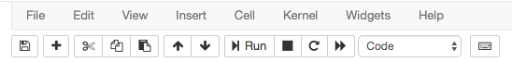
Don’t Forget to Save Your Notebooks
Even though Jupyter saves it every notebook you create, it is always good to give a meaningful name to your notebook, put some explanations at the very top, and save your file before you quit.
Another nice property is that you can download your notebook in various different formats.
HTML is very useful if you want to publish your notebooks.

Slide 59
Merging Notebooks
Merging notebooks is very simple.
First install “nbmerge” with
Then merge your files with
pip install nbmerge
nbmerge file_1.ipynb file_2.ipynb file_3.ipynb > merged.ipynb

Slide 60
QUESTIONS?

